Slide 1
INTELLIGENT WORK OS
TaskPilot
Does the AI assistant actually pay off?
We built a way to find out.
A working task manager with AI embedded in the workflow — and a built-in lab that measures whether the AI actually helped.
Team demo · Hackathon: Build a Small App Faster with AI

Slide 2
THE CHALLENGE
Leadership needs evidence, not vibes.
The brief: advise engineering leadership on whether to buy AI-assistant licenses at scale. That call shouldn’t rest on a good demo or a gut feeling.
500
◆
Measure actual time
Real elapsed minutes on comparable work — not a felt sense of "faster."
developer licenses on the table
↔
Report a balanced scorecard
Speed and quality together. A fast result that creates rework isn’t a clean win.
One good pilot, measured honestly, beats a thousand opinions.
●
Say where it helped — and where it didn’t
The honest answer sometimes points the other way. The tool has to allow that.
TaskPilot · AI Impact Lab
2

Slide 3
OUR APPROACH
AI lives inside the work — not on a separate chat tab.
One command bar creates tasks, plans the day, and breaks work into steps — in plain language. No context-switching to a chatbot to get help.
✓
✓
◆
One command bar
Works with zero setup
AI is optional, not assumed
"Add a high priority task to prep the investor deck tomorrow" — parsed and created instantly.
Every core feature — quick-add, decomposition, next-action insight — runs on local logic with no API key at all.
Add your own key for live AI answers. Nothing about the app depends on it being there.
TaskPilot · AI Impact Lab
3

Slide 4
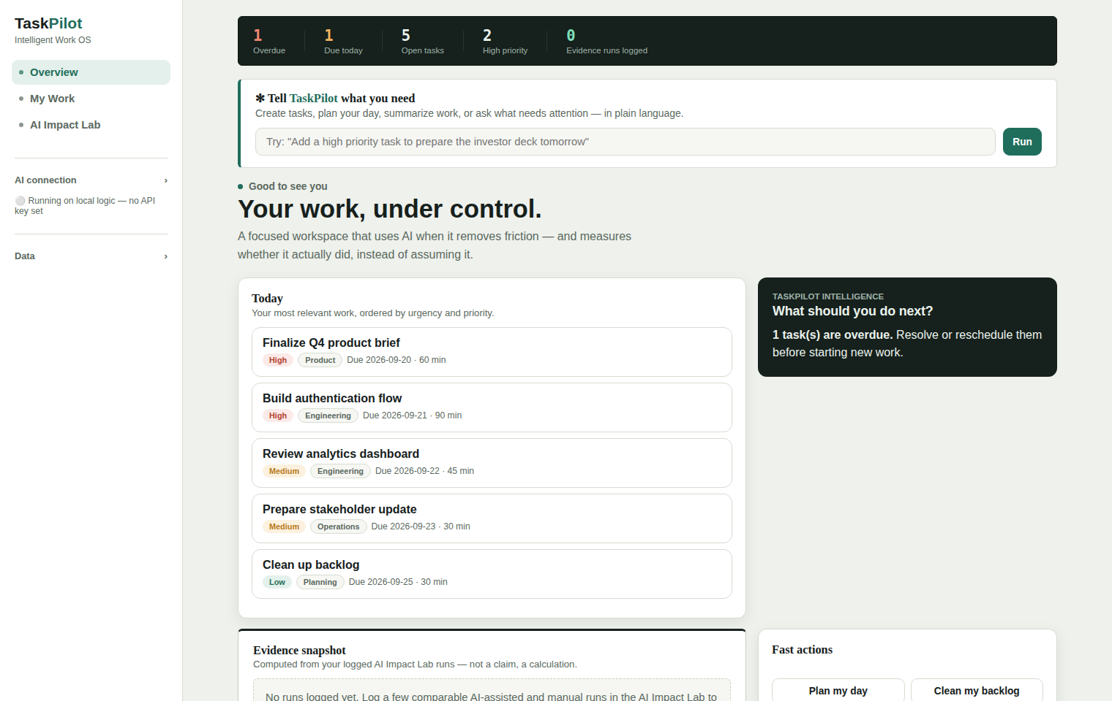
PRODUCT TOUR · 1 OF 2
Everything you need, one glance in.
A live readout
Overdue, due today, open, and high-priority counts — plus evidence runs logged, right at the top.
A next-action recommendation
TaskPilot reasons over your queue and tells you what to do next, and why.
An evidence snapshot
The same verdict from the AI Impact Lab, surfaced where you actually work.
TaskPilot · AI Impact Lab
4

Slide 5
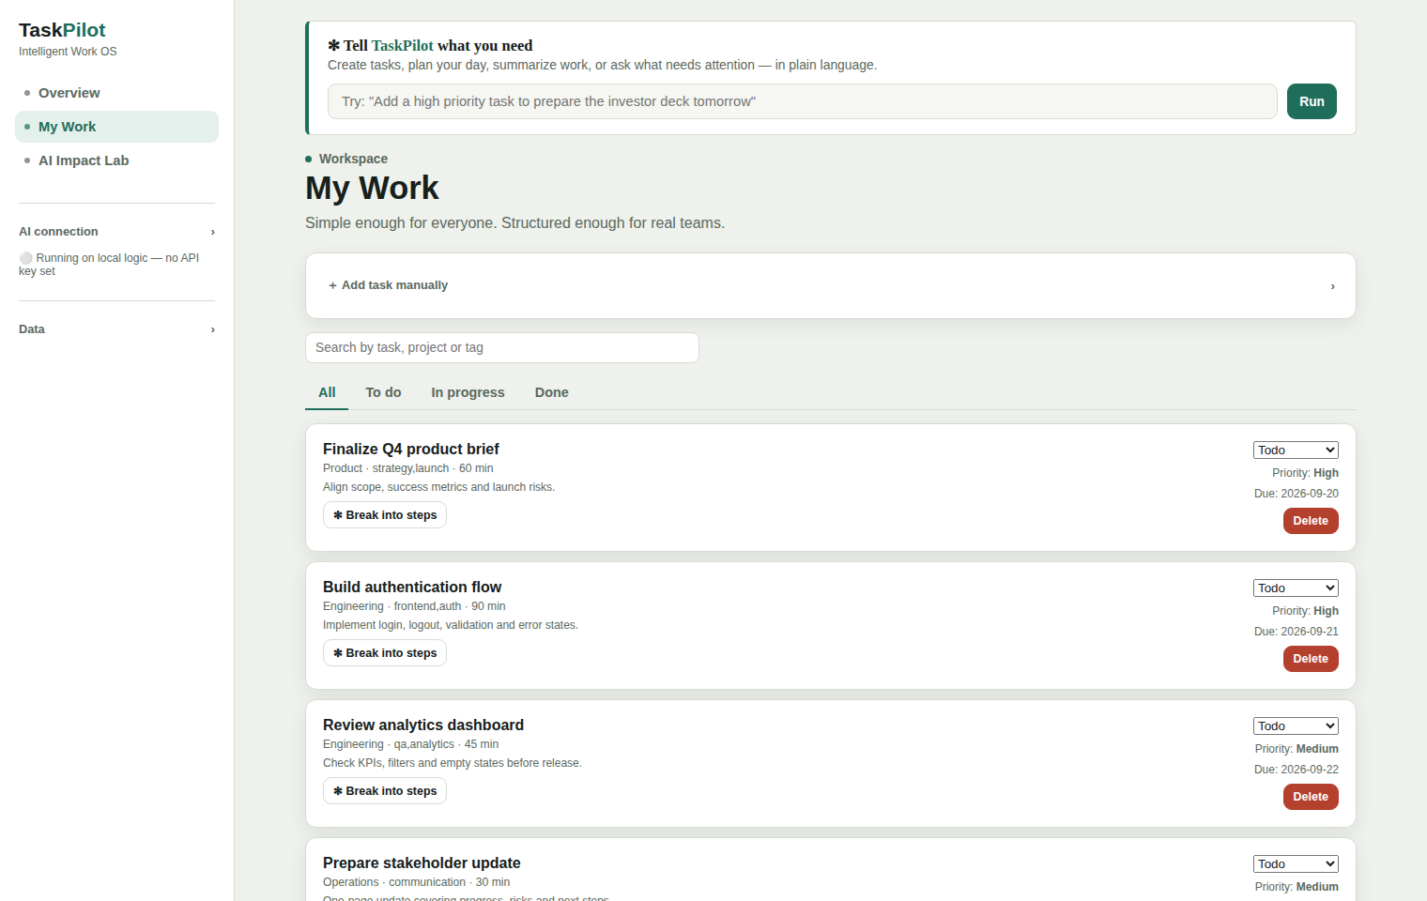
PRODUCT TOUR · 2 OF 2
Simple enough for anyone. Structured enough for real teams.
Search, filter, prioritize
Status, priority, due date, project and tags on every task.
"Break into steps"
One click turns any task into an ordered checklist — via AI, or a deterministic local fallback if no key is set.
Progress that updates itself
Checking off a step updates a visible progress bar automatically.
TaskPilot · AI Impact Lab
5

Slide 6
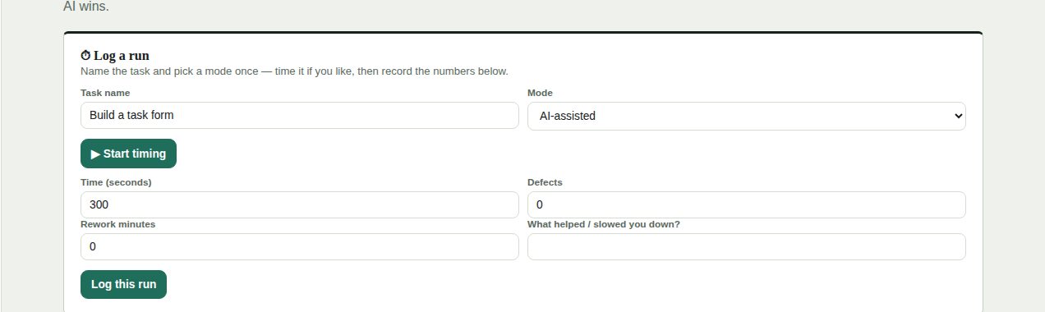
THE CENTERPIECE
The AI Impact Lab: three steps to a real answer.
1
2
3
Do the work twice
Log time, defects, rework
Get a computed verdict
Once with AI helping, once without — same task, timed with a built-in stopwatch.
Real seconds elapsed, mistakes caught, and minutes spent fixing things after.
The app derives the answer from the numbers you logged — it never assumes AI wins.
TaskPilot · AI Impact Lab
6

Slide 7
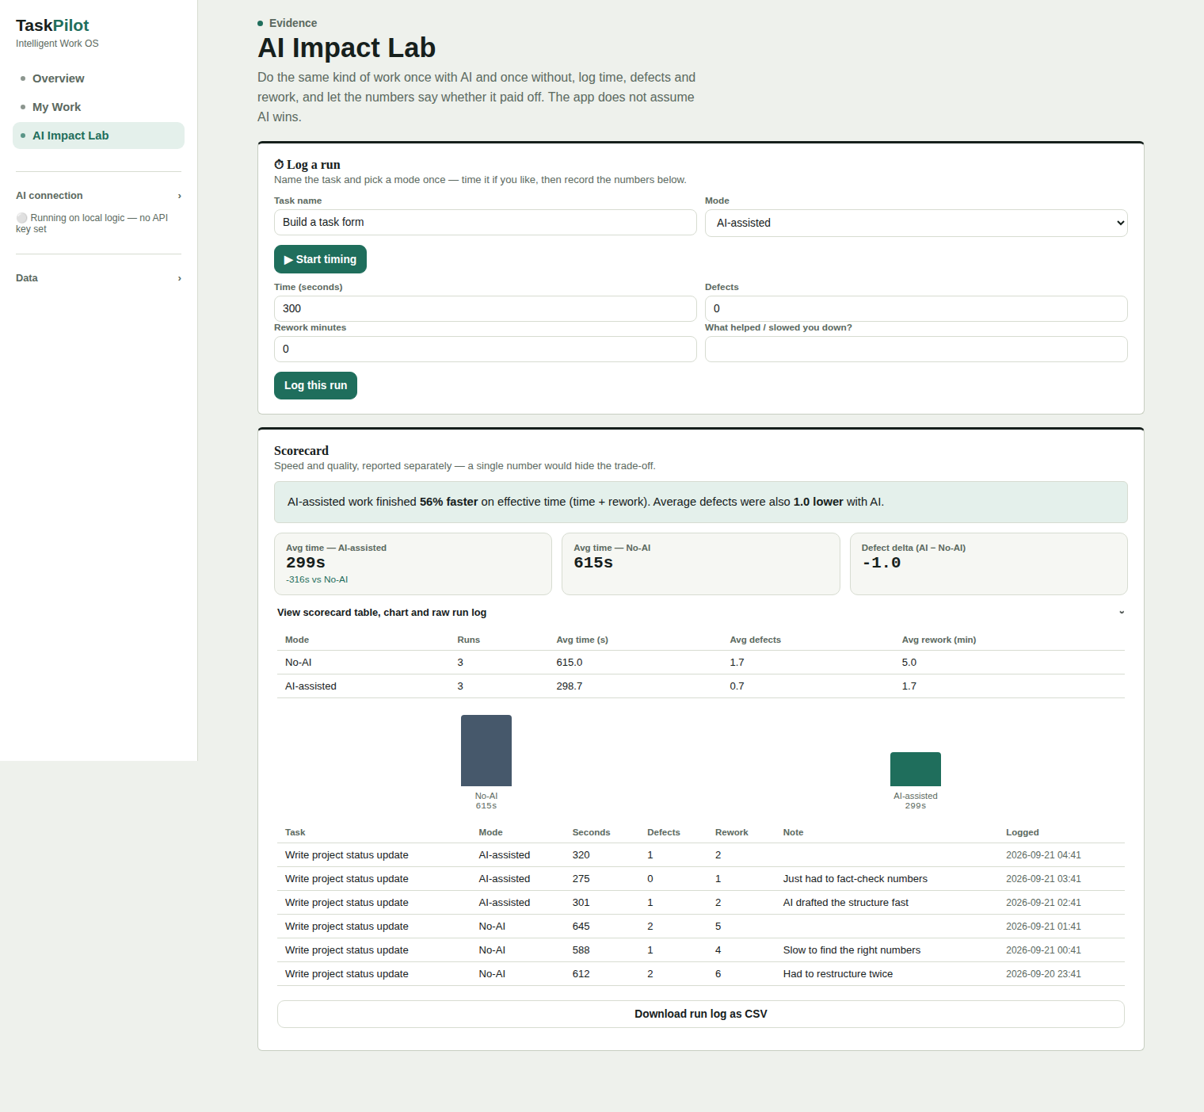
THIS IS NOT A MOCKUP
A real logged demo run: 56% faster, fewer defects.
Six runs of the same task ("write a project status update"), three per mode. The scorecard, chart and raw log below are computed live from that data.
TaskPilot · AI Impact Lab
7

Slide 8
WHY TRUST THE NUMBER
Built to be argued with, not just believed.
◆
Effective time, not just speed
↔
Can report a manual win
Time + rework minutes combined, so a fast-but-sloppy run can’t look better than it is.
The verdict logic isn’t scripted to favor AI — it says so plainly when manual work wins.
●
Flags a thin sample
↓
Raw data, exportable
Fewer than 3 runs per mode? It tells you outright instead of overstating confidence.
Every run — task, mode, time, defects, rework, note — downloads as CSV for anyone to check.
TaskPilot · AI Impact Lab
8

Slide 9
UNDER THE HOOD
One file. No install. No lock-in.
A single self-contained HTML/CSS/JavaScript file — open it in any browser and it runs.
Nothing to install
Local-first data
No Python, no server, no build step — double-click the file.
Tasks and logged runs are stored in the browser, private by default.
Bring your own AI key
Works fully offline
Optional OpenAI key unlocks live AI text; the app never depends on it.
Task management, decomposition and the Impact Lab all run without internet.
TaskPilot · AI Impact Lab
9

Slide 10
TRY IT YOURSELVES
Bring your own task. Log two runs. See your own number.
Open the file, pick something small you’d do this week, run it once with AI and once without, and let the AI Impact Lab do the math in front of you.
1. Open taskpilot.html
→
2. Log a No-AI run
→
3. Log an AI-assisted run
→
4. Read the verdict
No account, no install, no cost to try.

Slide 11
TaskPilot
Evidence, not vibes. Thank you — questions welcome.

